Slide 1
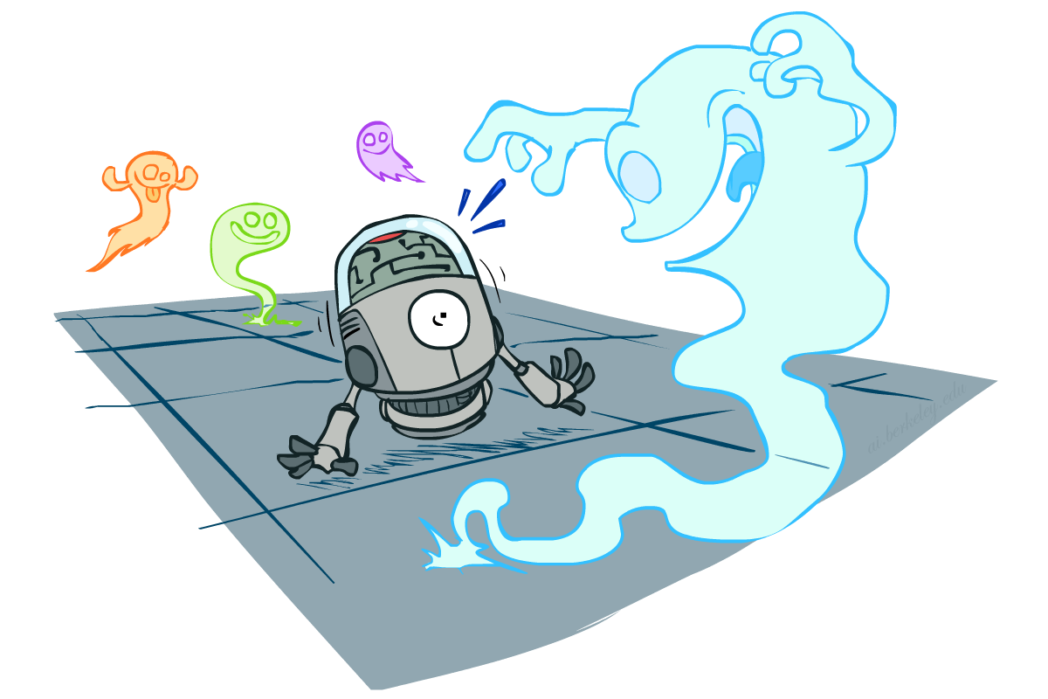
CS 188: Artificial Intelligence
Probability

Slide 2
Uncertainty
The real world is rife with uncertainty!
E.g., if I leave for Delhi 2 hours before my flight, will I be there in time?
Sources of Uncertainty:
partial observability (road state, other drivers’ plans, etc.)
noisy sensors (radio traffic reports, Google maps)
immense complexity of modelling and predicting traffic, security line, etc.
lack of knowledge of world dynamics (will tire burst?)
Probabilistic assertions summarize effects of ignorance and laziness
Combine probability theory + utility theory -> decision theory
Maximize expected utility : a* = argmax_{a} ∑_{s} P(s | a) U(s)

Slide 3
Basic laws of (discrete) probability
Begin with a set Ω of possible worlds
E.g., 6 possible rolls of a die, {1, 2, 3, 4, 5, 6}
A probability model assigns a number P(ω) to each world ω
E.g., P(1) = P(2) = P(3) = P(4) = P(5) = P(6) = 1/6.
These numbers must satisfy
0 ≤ P(ω) ≤ 1
∑_{ω ∈Ω} P(ω) = 1

Slide 4
Basic laws contd.
An event is any subset of Ω
E.g., “roll < 4” is the set {1,2,3}
E.g., “roll is odd” is the set {1,3,5}
The probability of an event is the sum of probabilities over its worlds
P(A) = ∑_{ω ∈ A} P(ω)
E.g., P(roll < 4) = P(1) + P(2) + P(3) = 1/2

Slide 5

Random Variables
A random variable (usually denoted by a capital letter) is some aspect of the world about which we (may) be uncertain
Formally a deterministic function of ω
The range of a random variable is the set of possible values
Odd = Is the dice roll an odd number? → {true, false}
e.g. Odd(1)=true, Odd(6) = false
often write the event Odd=true as odd, Odd=false as ¬odd
T = Is it hot or cold? → {hot, cold}
D = How long will it take to get to the airport? → [0, ∞)
L_{Ghost} = Where is the ghost? → {(0,0), (0,1), …}
The probability distribution of a random variable X gives the probability for each value x in its range (probability of the event X=x)
P(X=x) = ∑ _{{ω: X(ω)=x}} P(ω)
P(x) for short (when unambiguous)
P(X) refers to the entire distribution (think of it as a vector or table)

Slide 6
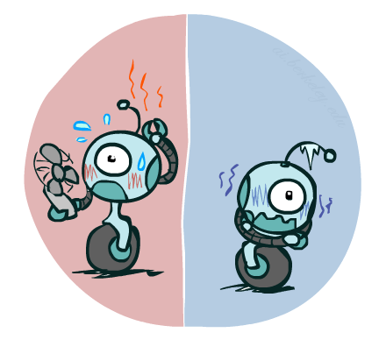
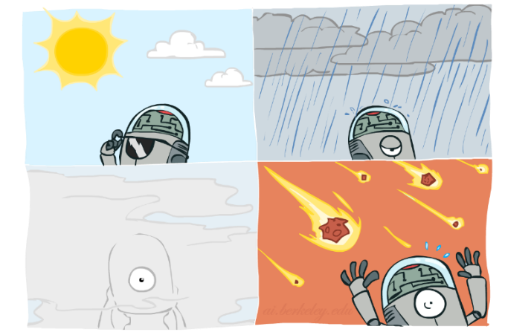
Probability Distributions
Associate a probability with each value; sums to 1
Temperature:
Weather:
Joint distribution
P(W)
P(T,W)
P(T)
W | P
sun | 0.6
rain | 0.1
fog | 0.3
meteor | 0.0
T | P
hot | 0.5
cold | 0.5
 |  | Temperature
 |  | hot | cold
Weather | sun | 0.45 | 0.15
 | rain | 0.02 | 0.08
 | fog | 0.03 | 0.27
 | meteor | 0.00 | 0.00
Note that the sum in each column or
row represents the probability of an
individual event (or its negation). So,
the sum of two rows or two columns
should add up to 1.

Slide 7
Making possible worlds
In many cases we
begin with random variables and their domains
construct possible worlds as assignments of values to all variables
E.g., two dice rolls Roll₁ and Roll₂
How many possible worlds?
What are their probabilities?
Size of distribution for n variables with range size d?
For all but the smallest distributions, cannot write out by hand!
d^{n}

Slide 8
Probabilities of events
Recall that the probability of an event is the sum of probabilities of its worlds:
P(A) = ∑_{ω ∈ A} P(ω)
So, given a joint distribution over all variables, can compute any event probability!
Probability that it’s hot AND sunny?
Probability that it’s hot?
Probability that it’s hot OR not foggy?
Joint distribution
P(T,W)
 |  | Temperature
 |  | hot | cold
Weather | sun | 0.45 | 0.15
 | rain | 0.02 | 0.08
 | fog | 0.03 | 0.27
 | meteor | 0.00 | 0.00

Slide 9
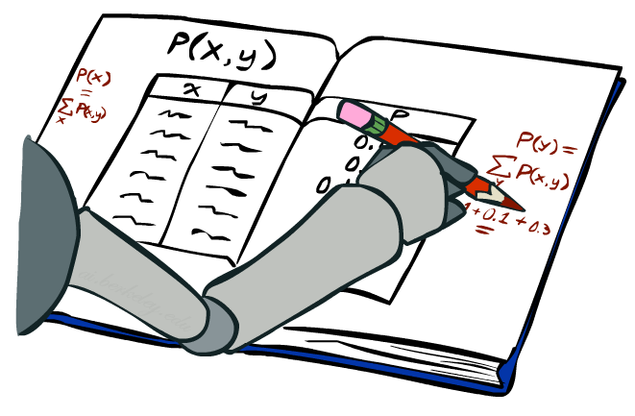
Marginal Distributions
Marginal distributions are sub-tables which eliminate variables
Marginalization (summing out): Collapse a dimension by adding
P(X=x) = ∑_{y} P(X=x, Y=y)
 |  | Temperature
 |  | hot | cold
Weather | sun | 0.45 | 0.15
 | rain | 0.02 | 0.08
 | fog | 0.03 | 0.27
 | meteor | 0.00 | 0.00
0.60
0.10
0.30
0.00
P(W)
0.50 | 0.50
P(T)

Slide 10
Conditional Probabilities
A simple relation between joint and conditional probabilities
In fact, this is taken as the definition of a conditional probability
P(a,b)
P(a, b)
P(b)
P(a | b) =
P(T,W)
P(a)
P(b)
 |  | Temperature
 |  | hot | cold
Weather | sun | 0.45 | 0.15
 | rain | 0.02 | 0.08
 | fog | 0.03 | 0.27
 | meteor | 0.00 | 0.00
P(W=s,T=c)
P(T=c)
P(W=s | T=c) =
= 0.15/0.50 = 0.3
= P(W=s,T=c) + P(W=r,T=c) + P(W=f,T=c) + P(W=m,T=c)
= 0.15 + 0.08 + 0.27 + 0.00= 0.50

Slide 11
Conditional Distributions
Distributions for one set of variables given another set
P(W | T=h)
P(W | T=c)
P(W | T)
 |  | Temperature
 |  | hot | cold
Weather | sun | 0.45 | 0.15
 | rain | 0.02 | 0.08
 | fog | 0.03 | 0.27
 | meteor | 0.00 | 0.00
hot
cold
hot
cold
0.90
0.04
0.06
0.00
0.30
0.16
0.54
0.00
0.90
0.04
0.06
0.00
0.30
0.16
0.54
0.00

Slide 12
Normalizing a distribution
(Dictionary) To bring or restore to a normal condition
Procedure:
Multiply each entry by α = 1/(sum over all entries)
All entries sum to ONE
P(W,T)
P(W | T=c) = P(W,T=c)/P(T=c)
= α P(W,T=c)
 |  | Temperature
 |  | hot | cold
Weather | sun | 0.45 | 0.15
 | rain | 0.02 | 0.08
 | fog | 0.03 | 0.27
 | meteor | 0.00 | 0.00
P(W,T=c)
0.15
0.08
0.27
0.00
0.30
0.16
0.54
0.00
Normalize
α = 1/0.50 = 2

Slide 13

The Product Rule
Sometimes have conditional distributions but want the joint
P(a | b) P(b) = P(a, b)
P(a, b)
P(b)
P(a | b) =

Slide 14
The Product Rule: Example
P(W | T) P(T) = P(W, T)
P(W | T)
P(W, T)
hot
cold
 |  | Temperature
 |  | hot | cold
Weather | sun | 0.45 | 0.15
 | rain | 0.02 | 0.08
 | fog | 0.03 | 0.27
 | meteor | 0.00 | 0.00
P(T)
0.90
0.04
0.06
0.00
0.30
0.16
0.54
0.00
T | P
hot | 0.5
cold | 0.5

Slide 15
The Chain Rule
A joint distribution can be written as a product of conditional distributions by repeated application of the product rule:
P(x₁, x₂, x₃) = P(x₃ | x₁, x₂) P(x₁, x₂) = P(x₃ | x₁, x₂) P(x₂ | x₁) P(x₁)
P(x₁, x₂,…, x_{n}) = ∏_{i} P(x_{i} | x₁,…, x_{i-1})

Slide 16

Probabilistic Inference
Probabilistic inference: compute a desired probability from a probability model
Typically for a query variable given evidence
E.g., P(airport on time | no accidents) = 0.90
These represent the agent’s beliefs given the evidence
Probabilities change with new evidence:
P(airport on time | no accidents, 5 a.m.) = 0.95
P(airport on time | no accidents, 5 a.m., raining) = 0.80
Observing new evidence causes beliefs to be updated

Slide 17
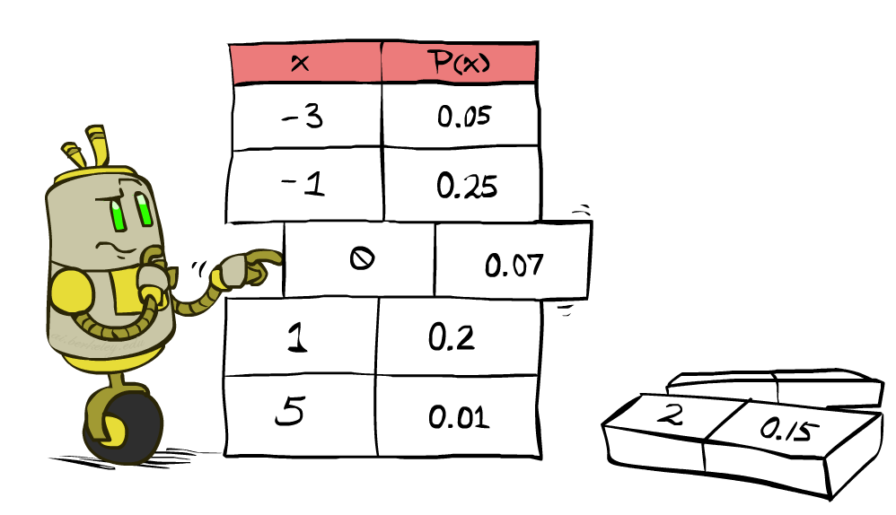
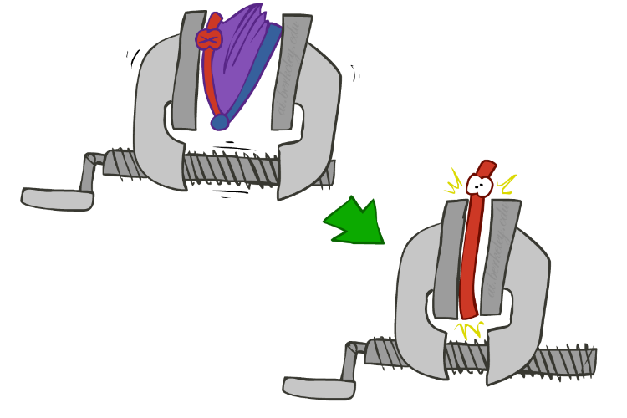
Inference by Enumeration
We want:
P(Q | e)
Probability model P(X₁, …, X_{n}) is given
Partition the variables X₁, …, X_{n} into sets as follows:
Evidence variables: E = e
Query variables: Q
Hidden variables: H
Step 1: Select the entries consistent with the evidence
Step 2: Sum out H from model to get joint of query and evidence
Step 3: Normalize
P(Q ,e) =
∑_{h} P(Q , h, e)
P(Q | e) = α P(Q ,e)
X₁, …, X_{n}

Slide 18
Inference by Enumeration
Season | Temp | Weather | P
summer | hot | sun | 0.35
summer | hot | rain | 0.01
summer | hot | fog | 0.01
summer | hot | meteor | 0.00
summer | cold | sun | 0.10
summer | cold | rain | 0.05
summer | cold | fog | 0.09
summer | cold | meteor | 0.00
winter | hot | sun | 0.10
winter | hot | rain | 0.01
winter | hot | fog | 0.02
winter | hot | meteor | 0.00
winter | cold | sun | 0.15
winter | cold | rain | 0.20
winter | cold | fog | 0.18
winter | cold | meteor | 0.00
P(W)?
P(W | winter)?

Slide 19
Probabilistic Belief
Consider a world where a dentist agent D meets with a new patient P
D is interested in only whether P has a cavity; so, a state is described with a single proposition – Cavity
Before observing P, D does not know if P has a cavity, but from years of practice, he believes Cavity with some probability p and ¬Cavity with probability 1 - p
The proposition is now a random variable and (Cavity, p) is a probabilistic belief

Slide 20
Joint Distribution - Example
 | Toothache | ¬Toothache
Cavity | 0.04 | 0.06
¬Cavity | 0.01 | 0.89
P(Cavity ∧ ¬Toothache)
P(¬Cavity ∧ Toothache)

Slide 21
Joint Distribution - Example
 | Toothache | ¬Toothache
Cavity | 0.04 | 0.06
¬Cavity | 0.01 | 0.89
P(Toothache)
= P( (Toothache ∧ Cavity) v (Toothache ∧ ¬Cavity) )
= P(Toothache ∧ Cavity) + P(Toothache ∧ ¬Cavity)
= 0.04 + 0.01 = 0.05

Slide 22
Joint Distribution - Example
 | Toothache | ¬Toothache
Cavity | 0.04 | 0.06
¬Cavity | 0.01 | 0.89
P(Toothache v Cavity)
= P( (Toothache ∧ Cavity) v (Toothache ∧ ¬Cavity) v (¬Toothache ∧ Cavity)
= 0.04 + 0.01 + 0.06 = 0.11

Slide 23
More Complex Inferences
Let’s now represent the world of the dentist D using three propositions – Cavity, Toothache, and PCatch
D’s belief state consists of 2³ = 8 states each with some probability:
{ Cavity∧Toothache∧PCatch, ¬Cavity∧Toothache∧PCatch, Cavity∧¬Toothache∧PCatch,
...
}

Slide 24
The belief state is defined by the full joint probability of the propositions
 | Toothache |  | ¬Toothache
 | PCatch | ¬PCatch | PCatch | ¬PCatch
Cavity | 0.108 | 0.012 | 0.072 | 0.008
¬Cavity | 0.016 | 0.064 | 0.144 | 0.576

Slide 25
Probabilistic Inference
Toothache
 | Toothache |  | ¬Toothache
 | PCatch | ¬PCatch | PCatch | ¬PCatch
Cavity | 0.108 | 0.012 | 0.072 | 0.008
¬Cavity | 0.016 | 0.064 | 0.144 | 0.576
P(Cavity ∨ Toothache)
= 0.108 + 0.012 + 0.072 + 0.008 + 0.016 + 0.064
= 0.28

Slide 26
Probabilistic Inference
 | Toothache |  | ¬Toothache
 | PCatch | ¬PCatch | PCatch | ¬PCatch
Cavity | 0.108 | 0.012 | 0.072 | 0.008
¬Cavity | 0.016 | 0.064 | 0.144 | 0.576
P(Cavity)
= 0.108 + 0.012 + 0.072 + 0.008
= 0.2

Slide 27
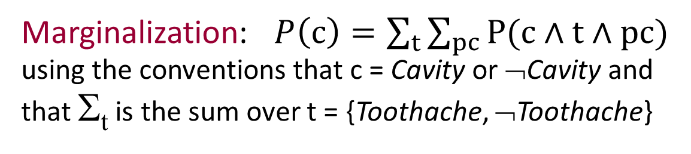
Probabilistic Inference
 | Toothache |  | ¬Toothache
 | PCatch | ¬PCatch | PCatch | ¬PCatch
Cavity | 0.108 | 0.012 | 0.072 | 0.008
¬Cavity | 0.016 | 0.064 | 0.144 | 0.576
Marginalization: $P\left(c\right)=\sum_{t}{\sum_{pc}{P(c∧t∧pc)}}$ using the conventions that c = Cavity or ¬Cavity and
that Σ_{t} is the sum over t = {Toothache, ¬Toothache}

Slide 28
Probabilistic Inference
 | Toothache |  | ¬Toothache
 | PCatch | ¬PCatch | PCatch | ¬PCatch
Cavity | 0.108 | 0.012 | 0.072 | 0.008
¬Cavity | 0.016 | 0.064 | 0.144 | 0.576
P(Cavity|Toothache)
= P(Cavity ∧ Toothache)/P(Toothache)
= (0.108+0.012)/(0.108+0.012+0.016+0.064) = 0.6

Slide 29
Probabilistic Inference
 | Toothache |  | ¬Toothache
 | PCatch | ¬PCatch | PCatch | ¬PCatch
Cavity | 0.108 | 0.012 | 0.072 | 0.008
¬Cavity | 0.016 | 0.064 | 0.144 | 0.576
P(Cavity|Toothache) = P(Cavity ∧ Toothache)/P(Toothache)
= (0.108+0.012)/(0.108+0.012+0.016+0.064) = 0.6
Interpretation: After observing Toothache, the patient is no longer an “average” one, and the prior probabilities of Cavity is no longer valid
P(Cavity|Toothache) is calculated by keeping the ratios of the probabilities of the 4 cases unchanged, and normalizing their sum to 1

Slide 30
 | Toothache |  | ¬Toothache
 | PCatch | ¬PCatch | PCatch | ¬PCatch
Cavity | 0.108 | 0.012 | 0.072 | 0.008
¬Cavity | 0.016 | 0.064 | 0.144 | 0.576
P(Cavity|Toothache) = P(Cavity ∧ Toothache)/P(Toothache)
= (0.108+0.012)/(0.108+0.012+0.016+0.064) = 0.6
P(¬Cavity|Toothache) = P(¬Cavity ∧ Toothache)/P(Toothache)
= (0.016+0.064)/(0.108+0.012+0.016+0.064) = 0.4
P(c|Toochache) = α P(c ∧Toothache) = α Σ_{pc} P(c ∧Toothache ∧ pc)
= α [(0.108, 0.016) + (0.012, 0.064)]
= α (0.12, 0.08) = (0.6, 0.4)
normalization constant

Slide 31
Inference by Enumeration
Obvious problems:
Worst-case time complexity O(d^{n}) (exponential in #hidden variables)
Space complexity O(d^{n}) to store the joint distribution
O(d^{n}) data points to estimate the entries in the joint distribution

Slide 32
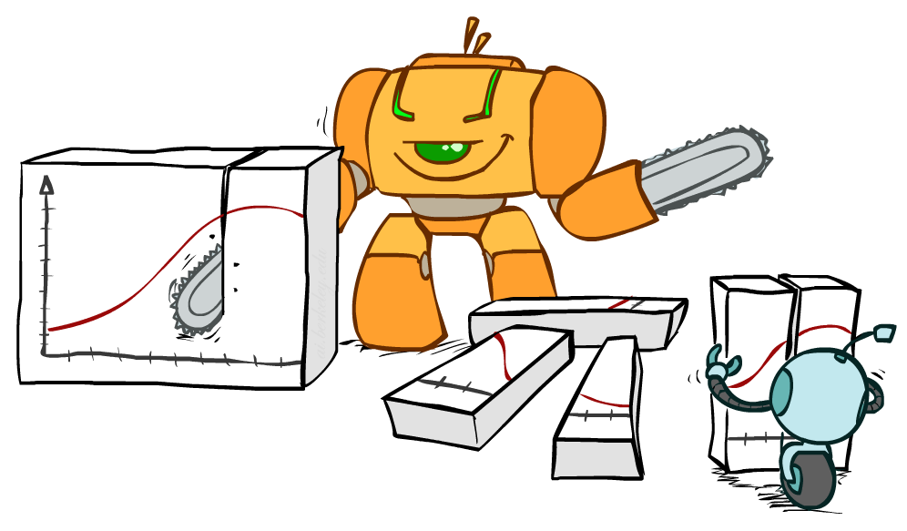
Bayes Rule

Slide 33
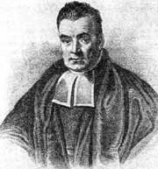
Bayes’ Rule
Write the product rule both ways:
P(a | b) P(b) = P(a, b) = P(b | a) P(a)
Dividing left and right expressions, we get:
Why is this at all helpful?
Let us build one conditional from its reverse
Often one conditional is tricky but the other one is simple
Describes an “update” step from prior P(a) to posterior P(a | b)
That’s my rule!
P(b | a) P(a)
P(b)
P(a | b) =

Slide 34
Inference with Bayes’ Rule
Example: We know that meningitis causes stiff neck 80% of the time. Prior probability of any patient having meningitis is 0.0001. Prior probability of any patient having stiff neck is 0.01.
M: meningitis, S: stiff neck
P(s | m) = 0.8
P(m) = 0.0001
P(s) = 0.01
Example
givens
P(s | m) P(m)
P(s)
0.8 x 0.0001 .
0.01
P(m | s) =
=
Note: posterior probability of meningitis still very small: 0.008

Slide 35

Independence
Two variables X and Y are (absolutely) independent if
∀x,y P(x, y) = P(x) P(y)
I.e., the joint distribution factors into a product of two simpler distributions
Equivalently, via the product rule P(x,y) = P(x|y)P(y),
P(x | y) = P(x) or P(y | x) = P(y)
Example: two dice rolls Roll₁ and Roll₂
P(Roll₁=5, Roll₂=3) = P(Roll₁=5) P(Roll₂=3) = 1/6 x 1/6 = 1/36
P(Roll₂=3 | Roll₁=5) = P(Roll₂=3)

Slide 36


Example: Independence
n fair, independent coin flips:
P(X₁)
P(X₂)
P(X_{n})
H | 0.5
T | 0.5
H | 0.5
T | 0.5
H | 0.5
T | 0.5
P(X₁,X₂,...,X_{n})
2^{n}

Slide 37
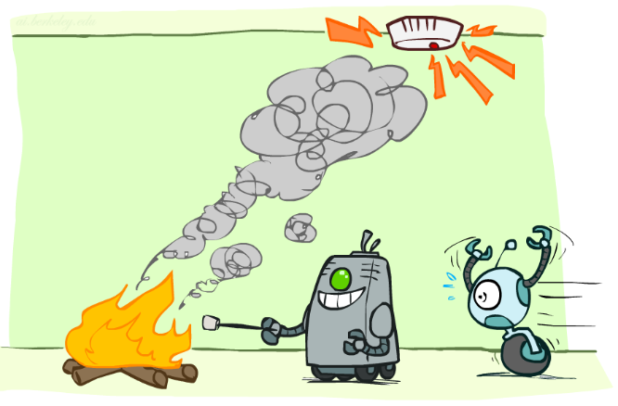
Conditional Independence

Slide 38
Conditional Independence
Conditional independence is our most basic and robust form of knowledge about uncertain environments.
X is conditionally independent of Y given Z if and only if:
∀x,y,z P(x | y, z) = P(x | z)
or, equivalently, if and only if
∀x,y,z P(x, y | z) = P(x | z) P(y | z)

Slide 39
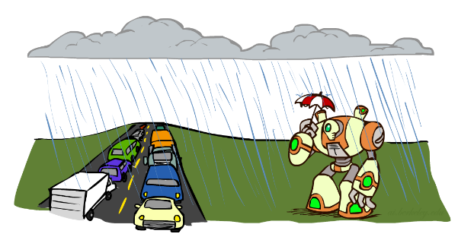
Conditional Independence Examples
What about this domain:
Traffic
Umbrella
Raining

Slide 40

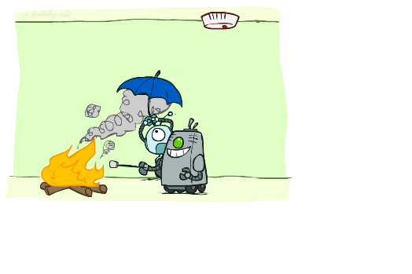
Conditional Independence Examples
What about this domain:
Fire
Smoke
Alarm

Slide 41
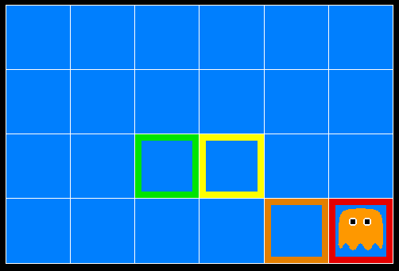
Ghostbusters
A ghost is in the grid somewhere
Sensor readings tell how close a square is to the ghost
On the ghost: usually red
1 or 2 away: mostly orange
3 or 4 away: typically yellow
5+ away: often green
Click on squares until confident of location, then “bust”

Slide 42

Video of Demo Ghostbusters with Probability

Slide 43
Ghostbusters model
0.11
0.11
0.11
Variables and ranges:
G (ghost location) in {(1,1),…,(3,3)}
C_{x,y} (color measured at square x,y) in {red,orange,yellow,green}
Ghostbuster physics:
Uniform prior distribution over ghost location: P(G)
Sensor model: P(C_{x,y} | G) (depends only on distance to G)
E.g. P(C_{1,1} = yellow | G = (1,1) ) = 0.1
0.11
0.11
0.11
0.11
0.11
0.11

Slide 44

Ghostbusters model, contd.
0.11
0.11
0.11
P(G, C_{1,1} , … C_{3,3}) has 9 x 4⁹ = 2,359,296 entries!!!
Ghostbuster independence:
Are C_{1,1} and C_{1,2} independent?
E.g., does P(C_{1,1} = yellow) = P(C_{1,1} = yellow | C_{1,2} = orange) ?
Ghostbuster physics again:
P(C_{x,y} | G) depends only on distance to G
So P(C_{1,1} = yellow | G = (2,3) ) = P(C_{1,1} = yellow | G = (2,3), C_{1,2} = orange)
I.e., C_{1,1} is conditionally independent of C_{1,2} given G
0.11
0.11
0.11
0.11
0.11
0.11

Slide 45
Ghostbusters model, contd.
Apply the chain rule to decompose the joint probability model:
P(G, C_{1,1} , … C_{3,3}) = P(G) P(C_{1,1} | G) P(C_{1,2} | G, C_{1,1}) P(C_{1,3} | G, C_{1,1}, C_{1,2}) … P(C_{3,3} | G, C_{1,1}, …, C_{3,2})
Now simplify using conditional independence:
P(G, C_{1,1} , … C_{3,3}) = P(G) P(C_{1,1} | G) P(C_{1,2} | G) P(C_{1,3} | G) … P(C_{3,3} | G)
I.e., conditional independence properties of ghostbuster physics simplify the probability model from exponential to quadratic in the number of squares
This is called a Naïve Bayes model:
One discrete query variable; all other variables are evidence variables
Evidence variables are conditionally independent given the query variable
G
C_{1,1}
C_{1,2}
C_{3,3}

Slide 46
To Summarize …
Basic laws: 0 ≤ P(ω) ≤ 1, ∑_{ω ∈Ω} P(ω) = 1, P(A) = ∑_{ω ∈ A} P(ω)
Random variable X(ω) has a value in each ω
Distribution P(X) gives probability for each possible value x
Joint distribution P(X,Y) gives total probability for each combination x,y
Summing out/marginalization: P(X=x) = ∑_{y} P(X=x,Y=y)
Conditional probability: P(X|Y) = P(X,Y)/P(Y)
Chain rule: P(X₁,..,X_{n}) = ∏_{i} P(X_{i} | X₁,..,X_{i-1})
Bayes Rule: P(X|Y) = P(Y|X)P(X)/P(Y)
Independence: P(X,Y) = P(X) P(Y) or P(X|Y) = P(X) or P(Y|X) = P(Y)
Conditional Independence: P(X|Y,Z) = P(X|Z) or P(X,Y|Z) = P(X|Z) P(Y| Z)

Slide 47
Next time
Bayes nets!

Slide 48
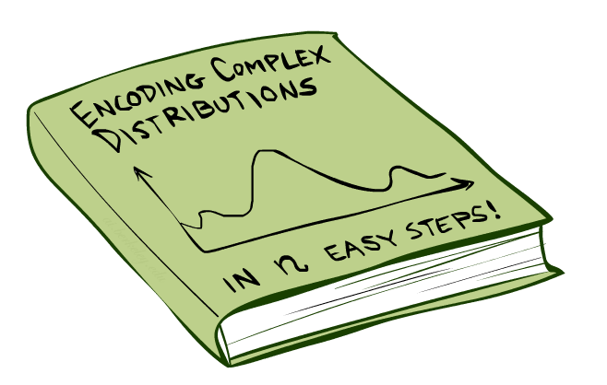
Bayes Nets: Big Picture

Slide 49
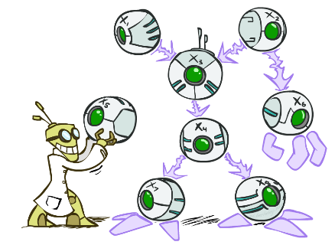
Bayes Nets: Big Picture
Bayes nets: a technique for describing complex joint distributions (models) using simple, conditional distributions
A subset of the general class of graphical models
Use local causality/conditional independence:
the world is composed of many variables,
each interacting locally with a few others

Slide 50
Bayes Nets
Part I: Basics, Representation
Part II: Exact inference
Part III: Independence
Part IV: Approximate Inference

Slide 51
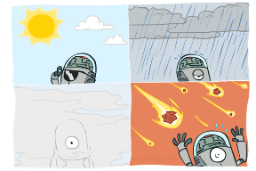
Graphical Model Notation
Nodes: variables (with domains)
Can be assigned (observed) or unassigned (unobserved)
Arcs: interactions
Indicate “direct influence” between variables
Formally: absence of arc encodes conditional independence (more later)
Weather
G
0.11
0.11
0.11
C_{1,1}
C_{1,2}
C_{3,3}
0.11
0.11
0.11
0.11
0.11
0.11

Slide 52

Example: Coin Flips
N independent coin flips
No interactions between variables: absolute independence
X₁
X₂
X_{n}

Slide 53
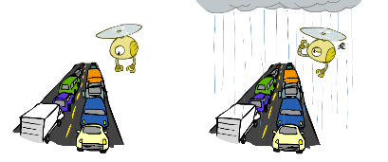
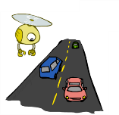
Example: Traffic
Variables:
T: There is traffic
U: I’m holding my umbrella
R: It rains
R
T
U

Slide 54
Example: Smoke alarm
Variables:
F: There is fire
S: There is smoke
A: Alarm sounds
F
S
A

Slide 55
Example Bayes’ Net: Car Insurance

Slide 56
Example Bayes’ Net: Car Won’t Start

Slide 57
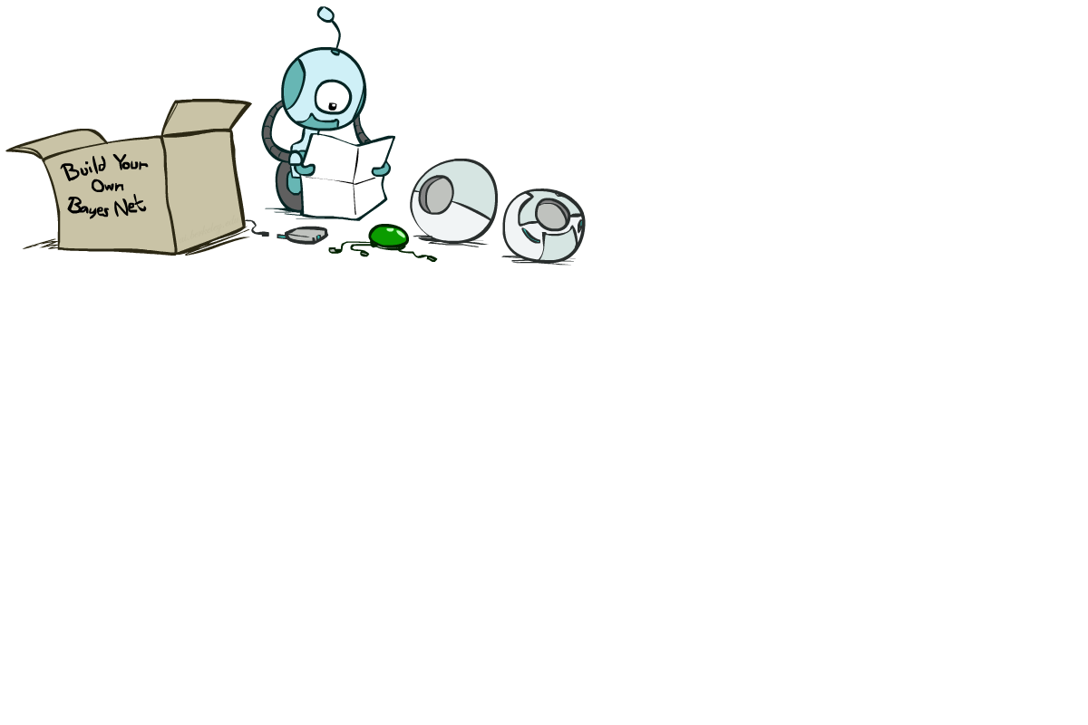
Bayes Net Syntax and Semantics

Slide 58
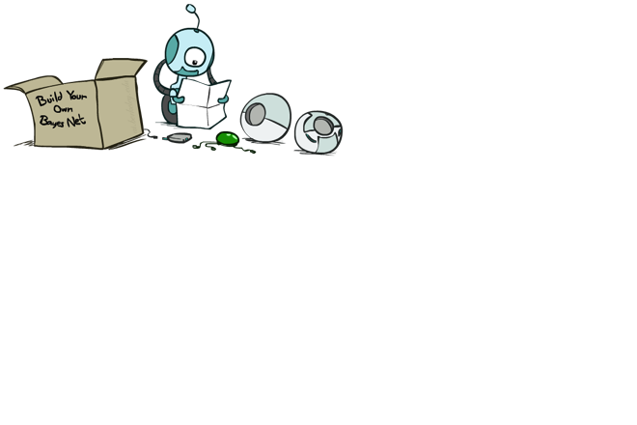
Bayes Net Syntax
A set of nodes, one per variable X
A directed, acyclic graph
A conditional distribution for each node given its parent variables in the graph
CPT (conditional probability table); each row is a distribution for child given values of its parents
P(G)
(1,1) | (1,2) | (1,3) | …
0.11 | 0.11 | 0.11 | …
G
C_{1,1}
C_{1,2}
C_{3,3}
G | P(C_{1,1} | G)
 | g | y | o | r
(1,1) | 0.01 | 0.1 | 0.3 | 0.59
(1,2) | 0.1 | 0.3 | 0.5 | 0.1
(1,3) | 0.3 | 0.5 | 0.19 | 0.01
…
Bayes net = Topology (graph) + Local Conditional Probabilities

Slide 59
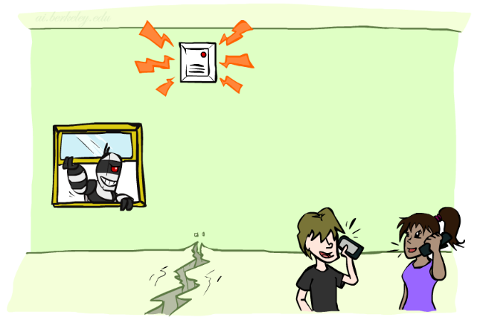
Example: Alarm Network
1
1
P(E)
true | false
0.002 | 0.998
P(B)
true | false
0.001 | 0.999
Burglary
Earthquake
B | E | P(A|B,E)
 |  | true | false
true | true | 0.95 | 0.05
true | false | 0.94 | 0.06
false | true | 0.29 | 0.71
false | false | 0.001 | 0.999
Alarm
4
Number of free parameters in each CPT:
Parent range sizes d₁,…,d_{k}
Child range size d
Each table row must sum to 1
(d-1) Π_{i} d_{i}
John calls
Mary calls
A | P(J|A)
 | true | false
true | 0.9 | 0.1
false | 0.05 | 0.95
A | P(M|A)
 | true | false
true | 0.7 | 0.3
false | 0.01 | 0.99
2
2
Notes:
demo

Slide 60
General formula for sparse BNs
Suppose
n variables
Maximum range size is d
Maximum number of parents is k
Full joint distribution has size O(d^{n})
Bayes net has size O(n .d^{k})
Linear scaling with n as long as causal structure is local

Slide 61
Bayes net global semantics
Bayes nets encode joint distributions as product of conditional distributions on each variable:
P(X₁,..,X_{n}) = ∏_{i} P(X_{i} | Parents(X_{i}))

Slide 62
Example
P(E)
true | false
0.002 | 0.998
P(b,¬e, a, ¬j, ¬m) =
P(B)
true | false
0.001 | 0.999
Burglary
Earthquake
P(b)
P(¬e)
P(a|b,¬e)
P(¬j|a)
P(¬m|a)
=.001x.998x.94x.1x.3=.000028
B | E | P(A|B,E)
 |  | true | false
true | true | 0.95 | 0.05
true | false | 0.94 | 0.06
false | true | 0.29 | 0.71
false | false | 0.001 | 0.999
Alarm
John calls
Mary calls
A | P(J|A)
 | true | false
true | 0.9 | 0.1
false | 0.05 | 0.95
A | P(M|A)
 | true | false
true | 0.7 | 0.3
false | 0.01 | 0.99

Slide 63
Conditional independence in BNs
Compare the Bayes net global semantics
P(X₁,..,X_{n}) = ∏_{i} P(X_{i} | Parents(X_{i}))
with the chain rule identity
P(X₁,..,X_{n}) = ∏_{i} P(X_{i} | X₁,…,X_{i-1})
Assume (without loss of generality) that X₁,..,X_{n} sorted in topological order according to the graph (i.e., parents before children), so Parents(X_{i}) ⊆ X₁,…,X_{i-1}
The Bayes net asserts conditional independences P(X_{i} | X₁,…,X_{i-1}) = P(X_{i} | Parents(X_{i}))
To ensure these are valid, choose parents for node X_{i} that “shield” it from other predecessors

Slide 64
Conditional independence semantics
Every variable is conditionally independent of its non-descendants given its parents
Conditional independence semantics <=> global semantics

Slide 65
Example: Burglary
P(B)
true | false
0.001 | 0.999
P(E)
true | false
0.002 | 0.998
Burglary
Earthquake
Alarm
Burglary
?
Earthquake
?
?
Alarm
B | E | P(A|B,E)
 |  | true | false
true | true | 0.95 | 0.05
true | false | 0.94 | 0.06
false | true | 0.29 | 0.71
false | false | 0.001 | 0.999

Slide 66
Example: Burglary
P(A)
true | false
Alarm
Burglary
Earthquake
Alarm
?
?
A | B | P(E|A,B)
 |  | true | false
true | true
true | false
false | true
false | false
A | P(B|A)
 | true | false
true
false
Burglary
Earthquake
?
?
?

Slide 67

Inference
Inference: calculating some useful quantity from a probability model (joint probability distribution)
Examples:
Posterior marginal probability
P(Q|e₁,..,e_{k})
E.g., what disease might I have?
Most likely explanation:
argmax_{q,r,s} P(Q=q,R=r,S=s|e₁,..,e_{k})
E.g., what did they say?

Slide 68
Inference by Enumeration in Bayes Net
Reminder of inference by enumeration:
Any probability of interest can be computed by summing entries from the joint distribution: P(Q | e) = α ∑_{h} P(Q , h, e)
Entries from the joint distribution can be obtained from a BN by multiplying the corresponding conditional probabilities
P(B | j, m) = α ∑_{e,a} P(B, e, a, j, m)
= α ∑_{e,a} P(B) P(e) P(a|B,e) P(j|a) P(m|a)
So, inference in Bayes nets means computing sums of products of numbers. Sounds easy!!
Problem: sums of exponentially many products!
B
E
A
J
M

Slide 69
Can we do better?
Consider uwy + uwz + uxy + uxz + vwy + vwz + vxy +vxz
16 multiplies, 7 adds
Lots of repeated sub-expressions!
Rewrite as (u+v)(w+x)(y+z)
2 multiplies, 3 adds
∑_{e,a} P(B) P(e) P(a|B,e) P(j|a) P(m|a)
= P(B)P(e)P(a|B,e)P(j|a)P(m|a) + P(B)P(¬e)P(a|B,¬e)P(j|a)P(m|a)
+ P(B)P(e)P(¬a|B,e)P(j|¬a)P(m|¬a) + P(B)P(¬e)P(¬a|B,¬e)P(j|¬a)P(m|¬a)
Lots of repeated sub-expressions!

Slide 70

To Summarize …
Independence and conditional independence are important forms of probabilistic knowledge
Bayes net encode joint distributions efficiently by taking advantage of conditional independence
Global joint probability = product of local conditionals
Exact inference = sums of products of conditional probabilities from the network

Slide 71

Next Time
Part I: Basics, Representation
Part II: Exact inference
Enumeration (always exponential complexity)
Variable elimination (worst-case exponential complexity, often better)
Part III: Independence
Part IV: Approximate Inference

Slide 72
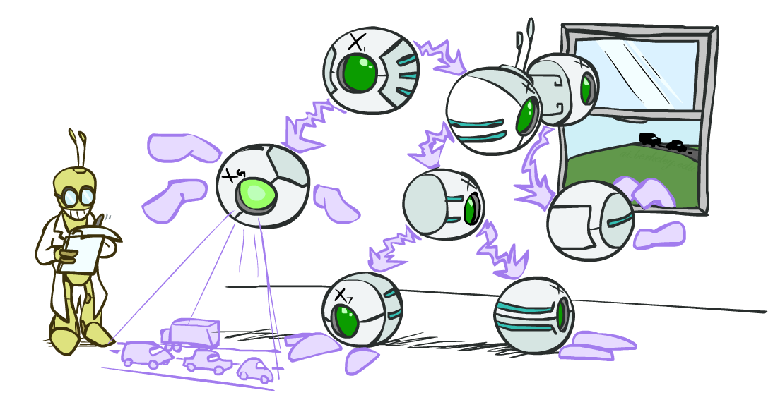
Bayes Nets: Exact Inference
Notes:
Please retain proper attribution, including the reference to ai.berkeley.edu. Thanks!

Slide 73

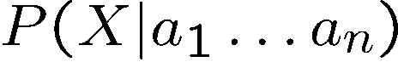
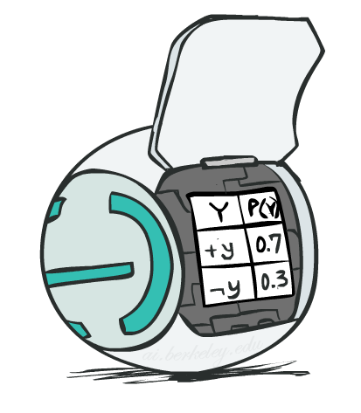
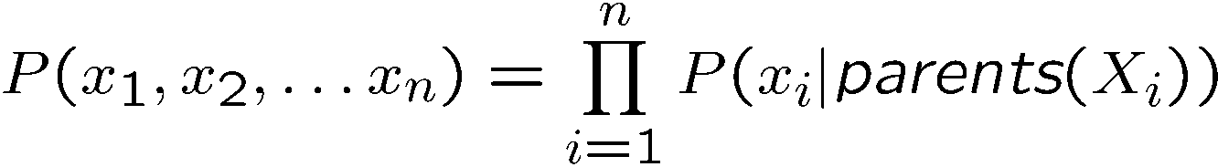
Bayes Net Semantics
A Bayes net is an efficient encoding of a probabilistic model of a domain
A directed, acyclic graph, one node per random variable
A conditional probability table (CPT) for each node
A collection of distributions over X, one for each combination of parents’ values
Bayes’ nets implicitly encode joint distributions
As a product of local conditional distributions
To see what probability a BN gives to a full assignment, multiply all the relevant conditionals together:

Slide 74
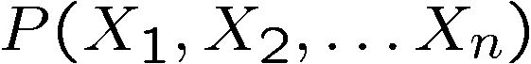
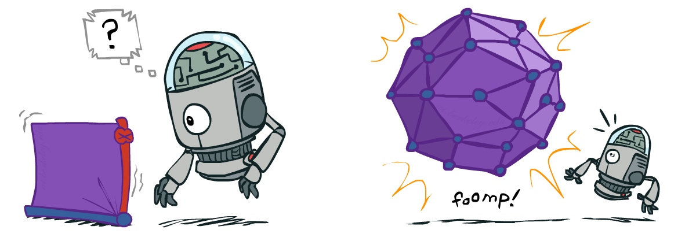
Size of a Bayes Net
How big is a joint distribution over N Boolean variables?
2^{N}
How big is an N-node net if nodes have up to k parents?
O(N * 2^{k+1})
Both give you the power to calculate
BNs: Huge space savings!
Also easier to elicit local CPTs
Also faster to answer queries (this lecture!)

Slide 75
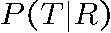
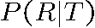
Causality?
BNs need not actually be causal
Sometimes no causal net exists over the domain (especially if variables are missing)
E.g. consider the variables Traffic and Rain
+r | 1/4
-r | 3/4
+t | 9/16
-t | 7/16
R
T
+r | +t | 3/4
 | -t | 1/4
+t | +r | 1/3
 | -r | 2/3
T
R
-r | +t | 1/2
 | -t | 1/2
-t | +r | 1/7
 | -r | 6/7

Slide 76
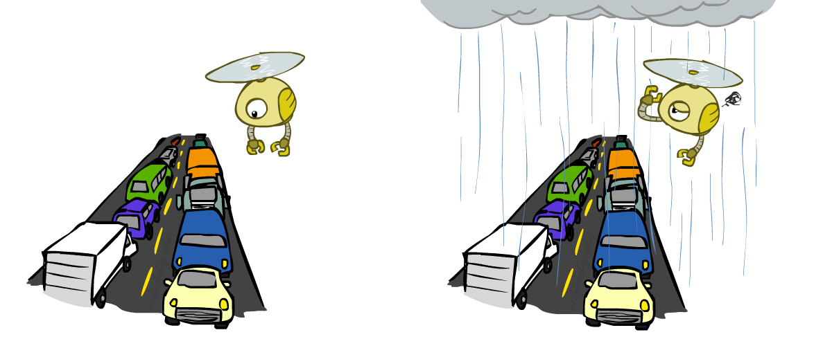
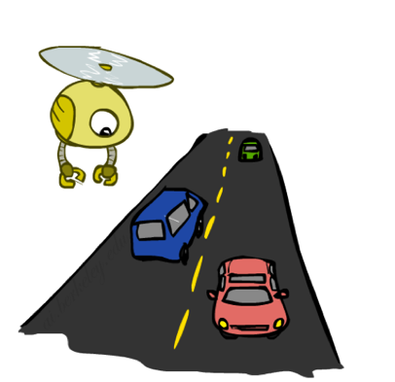
Example: Traffic
Causal direction
R
+r | 1/4
-r | 3/4
+r | +t | 3/16
+r | -t | 1/16
-r | +t | 6/16
-r | -t | 6/16
+r | +t | 3/4
 | -t | 1/4
T
-r | +t | 1/2
 | -t | 1/2

Slide 77
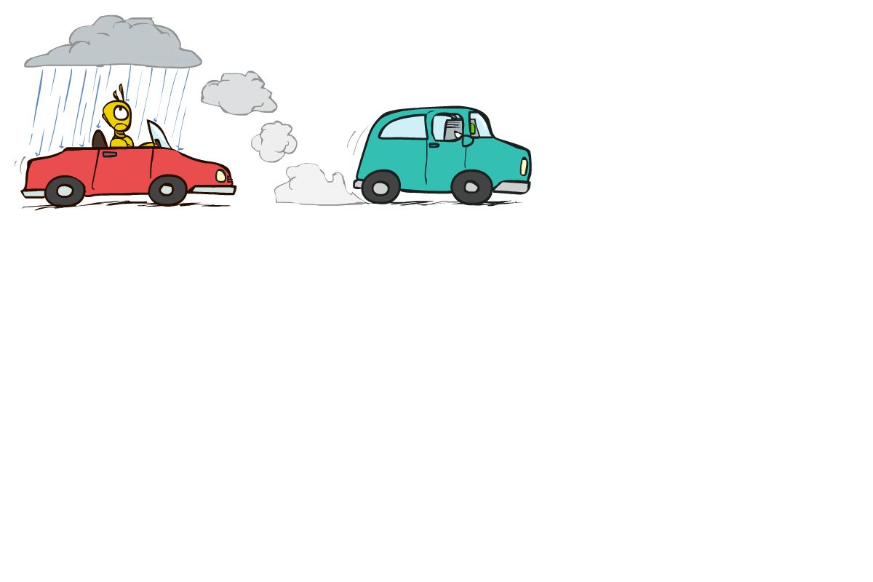
Example: Reverse Traffic
Reverse causality?
T
+t | 9/16
-t | 7/16
+r | +t | 3/16
+r | -t | 1/16
-r | +t | 6/16
-r | -t | 6/16
+t | +r | 1/3
 | -r | 2/3
R
-t | +r | 1/7
 | -r | 6/7

Slide 78
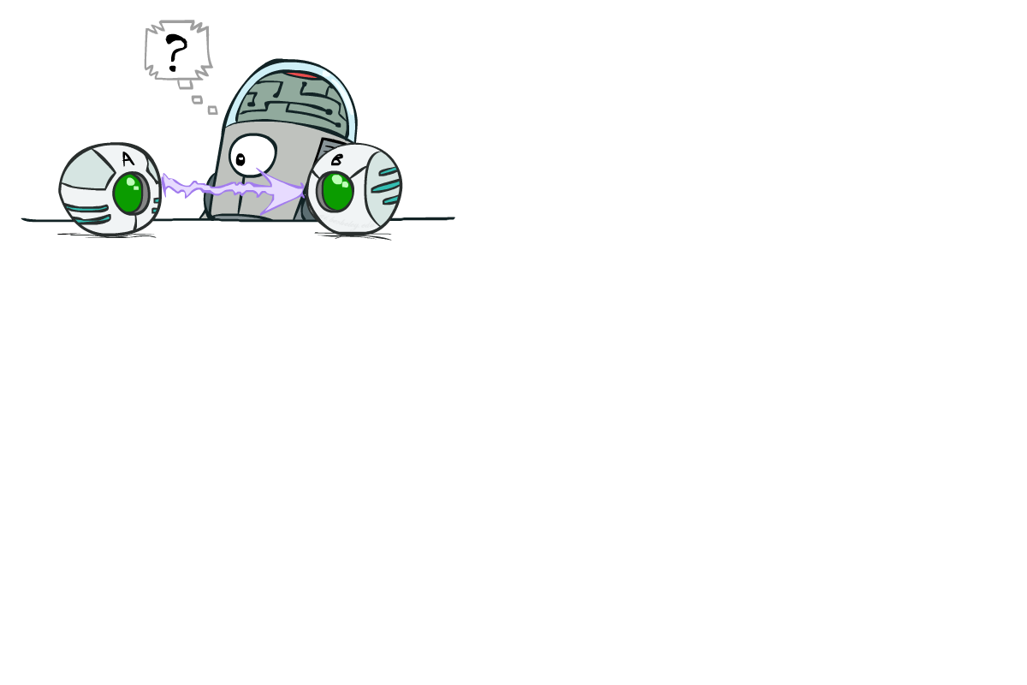
Causality?
When Bayes’ nets reflect the true causal patterns:
Often simpler (nodes have fewer parents)
Often easier to think about
Often easier to estimate probabilities from data
BNs need not actually be causal
Sometimes no causal net exists over the domain (especially if variables are missing)
E.g. consider the variables Traffic and Drips
End up with arrows that reflect correlation, not causation
What do the arrows really mean?
Topology may happen to encode causal structure
Topology really encodes conditional independence

Slide 79
Inference by Enumeration in Bayes Net
Reminder of inference by enumeration:
Any probability of interest can be computed by summing entries from the joint distribution: P(Q | e) = α ∑_{h} P(Q , h, e)
Entries from the joint distribution can be obtained from a BN by multiplying the corresponding conditional probabilities
P(B | j, m) = α ∑_{e,a} P(B, e, a, j, m)
= α ∑_{e,a} P(B) P(e) P(a|B,e) P(j|a) P(m|a)
Problem: sums of exponentially many products!
B
E
A
J
M

Slide 80
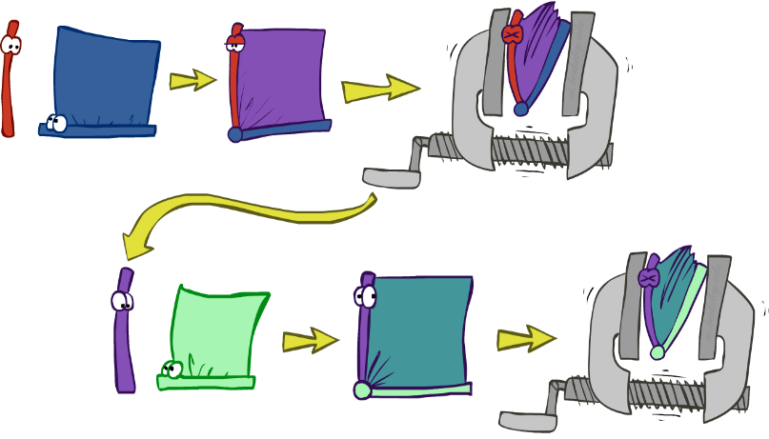
Variable elimination: The basic ideas
Move summations inwards as far as possible
P(B | j, m) = α ∑_{e,a} P(B) P(e) P(a|B,e) P(j|a) P(m|a)
= α P(B) ∑_{e} P(e) ∑_{a} P(a|B,e) P(j|a) P(m|a)
Do the calculation from the inside out
I.e., sum over a first, then sum over e
Challenge: P(a|B,e) isn’t a single number, it’s a table of different numbers (depending on the values of B and e)
Solution: use arrays of numbers with appropriate operations on them; these are called factors

Slide 81

Factor Zoo I
Joint distribution: P(X,Y)
Entries P(x,y) for all x, y
|X|x|Y| matrix
Sums to 1
Projected joint: P(x,Y)
A slice of the joint distribution
Entries P(x,y) for one x, all y
|Y|-element vector
Sums to P(x)
P(A,J)
A \ J | true | false
true | 0.09 | 0.01
false | 0.045 | 0.855
P(a,J) = P_{a}(J)
A \ J | true | false
true | 0.09 | 0.01
Number of variables (capitals) = dimensionality of the table

Slide 82
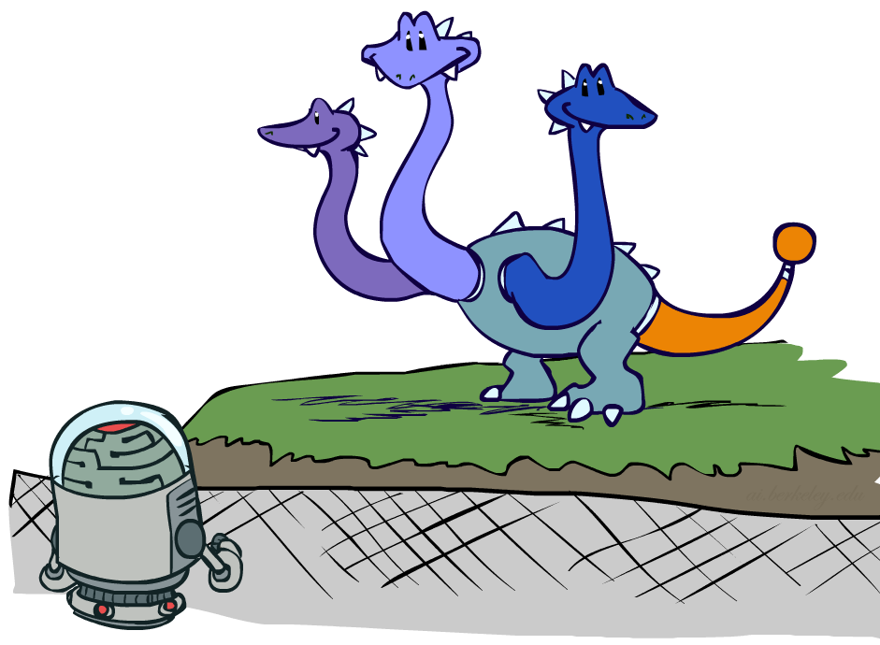
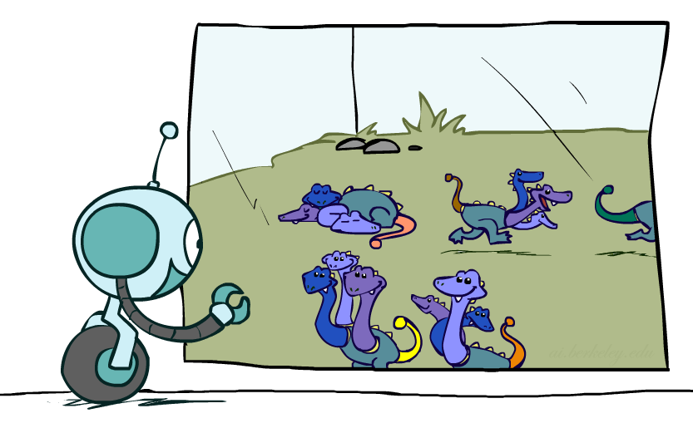
Factor Zoo II
P(J|a)
Single conditional: P(Y | x)
Entries P(y | x) for fixed x, all y
Sums to 1
Family of conditionals:
P(X |Y)
Multiple conditionals
Entries P(x | y) for all x, y
Sums to |Y|
A \ J | true | false
true | 0.9 | 0.1
P(J|A)
A \ J | true | false
true | 0.9 | 0.1
false | 0.05 | 0.95
} - P(J|a)
} - P(J|¬a)

Slide 83

Operation 1: Pointwise product
First basic operation: pointwise product of factors (not matrix multiply!)
New factor has union of variables of the two original factors
Each entry is the product of the corresponding entries from the original factors
Example: P(J|A) x P(A) = P(A,J)
P(J|A)
P(A,J)
P(A)
A \ J | true | false
true | 0.9 | 0.1
false | 0.05 | 0.95
A \ J | true | false
true | 0.09 | 0.01
false | 0.045 | 0.855
true | 0.1
false | 0.9
x
=

Slide 84
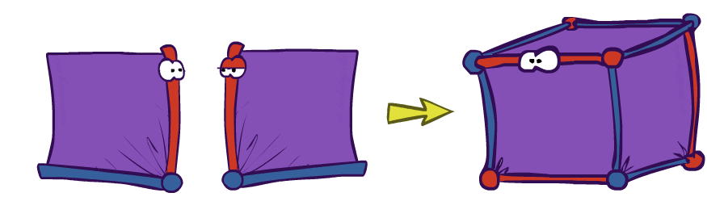
Example: Making larger factors
Example: P(A,J) x P(M|A) = P(A,J,M)
Factor blowup can make VE very expensive!
P(A,J,M)
P(A,J)
P(M | A)
J \ M | true | false
true
false |  | 0.846
A \ J | true | false
true | 0.09 | 0.01
false | 0.045 | 0.855
A \ M | true | false
true | 0.7 | 0.3
false | 0.01 | 0.99
J \ M | true | false
true
false |  | 0.003
x
=
A=false
A=true

Slide 85
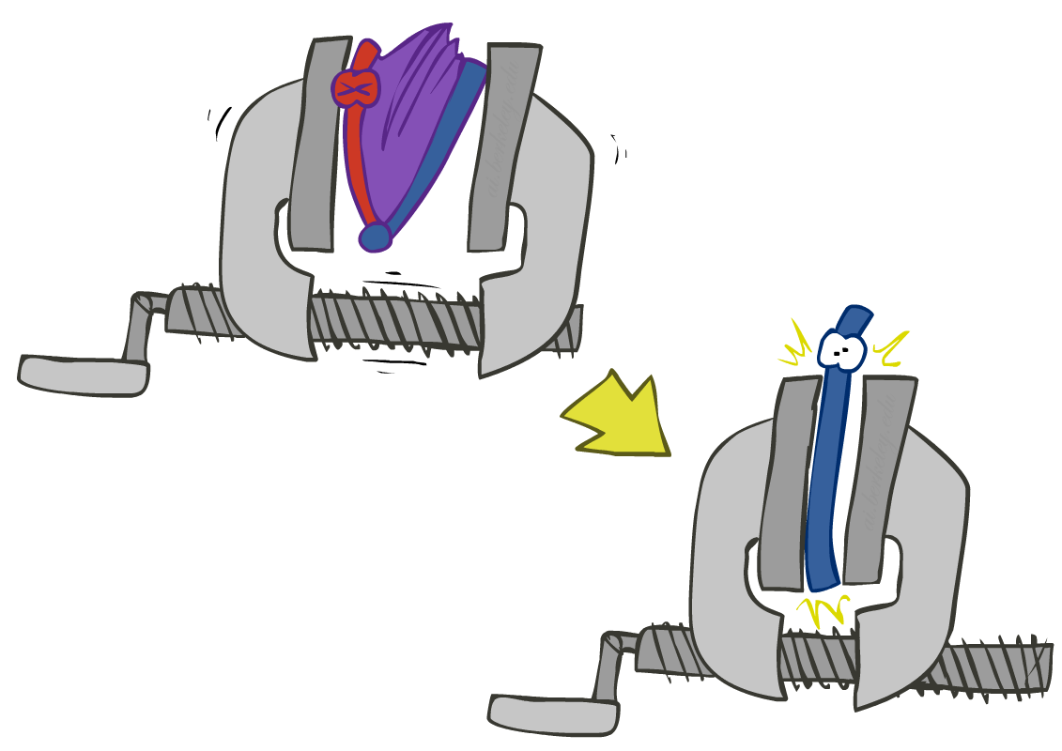
Operation 2: Summing out a variable
Second basic operation: summing out (or eliminating) a variable from a factor
Shrinks a factor to a smaller one
Example: ∑_{j} P(A,J) = P(A,j) + P(A,¬j) = P(A)
P(A,J)
P(A)
A \ J | true | false
true | 0.09 | 0.01
false | 0.045 | 0.855
Sum out J
true | 0.1
false | 0.9

Slide 86

Variable Elimination

Slide 87

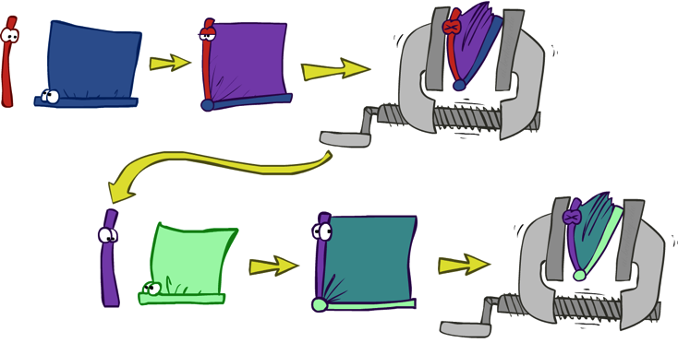
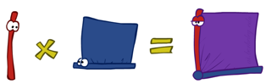
Variable Elimination
Query: P(Q|E₁=e₁,.., E_{k}=e_{k})
Start with initial factors:
Local CPTs (but instantiated by evidence)
While there are still hidden variables (not Q or evidence):
Pick a hidden variable H_{j}
Eliminate (sum out) H_{j} from the product of all factors mentioning H_{j}
Join all remaining factors and normalize
X α

Slide 88
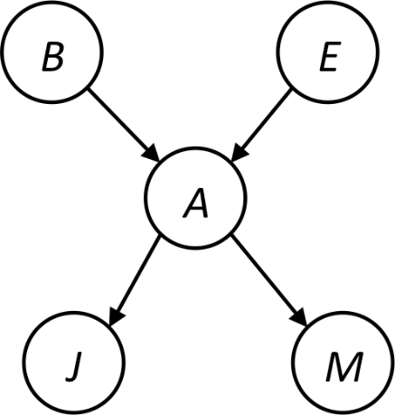

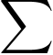
Example
Query P(B | j,m)
P(B) P(E) P(A|B,E) P(j|A) P(m|A)
Choose A
P(A|B,E)
P(j|A)
P(m|A)
P(j,m|B,E)
P(B) P(E) P(j,m|B,E)

Slide 89
Example
P(B) P(E) P(j,m|B,E)
Choose E
P(E)
P(j,m|B,E)
P(j,m|B)
P(B) P(j,m|B)
Finish with B
P(B)
P(j,m|B)
P(j,m,B)
Normalize
P(B | j,m)

Slide 90

Summing out from a product of factors
Project the factors each way first, then sum the products
Example: ∑_{a} P(a|B,e) x P(j|a) x P(m|a)
= P(a|B,e) x P(j|a) x P(m|a) +
P(¬a|B,e) x P(j|¬a) x P(m|¬a)

Slide 91
Order matters
Z
Order the terms Z, A, B C, D
P(D) = α ∑_{z,a,b,c} P(z) P(a|z) P(b|z) P(c|z) P(D|z)
= α ∑_{z} P(z) ∑_{a} P(a|z) ∑_{b} P(b|z) ∑_{c} P(c|z) P(D|z)
Largest factor has 2 variables (D,Z)
Order the terms A, B C, D, Z
P(D) = α ∑_{a,b,c,z} P(a|z) P(b|z) P(c|z) P(D|z) P(z)
= α ∑_{a} ∑_{b} ∑_{c} ∑_{z} P(a|z) P(b|z) P(c|z) P(D|z) P(z)
Largest factor has 4 variables (A,B,C,D)
In general, with n leaves, factor of size 2^{n}
A
B
C
D

Slide 92
VE: Computational and Space Complexity
The computational and space complexity of variable elimination is determined by the largest factor (and it’s space that kills you)
The elimination ordering can greatly affect the size of the largest factor.
E.g., previous slide’s example 2^{n} vs. 2
Does there always exist an ordering that only results in small factors?
No!

Slide 93
Worst Case Complexity? Reduction from SAT
0.5
0.5
0.5
0.5
Variables: W, X, Y, Z
CNF clauses:
C₁ = W v X v Y
C₂ = Y v Z v ¬ W
C₃ = X v Y v ¬Z
Sentence S = C₁ ∧ C₂ ∧ C₃
P(S) > 0 iff S is satisfiable
=> NP-hard
P(S) = K x 0.5^{n} where K is the number of satisfying assignments for clauses
=> #P-hard
W
X
Y
Z
¬
¬
C₁
C₂
C₃
S
Notes:
Make this model simpler (no reason for fan-in constraint)

Slide 94
Polytrees
A polytree is a directed graph with no undirected cycles
For poly-trees the complexity of variable elimination is linear in the network size if you eliminate from the leave towards the roots

Slide 95
Bayes Nets
Part I: Representation
Part II: Exact inference
Enumeration (always exponential complexity)
Variable elimination (worst-case exponential complexity, often better)
Inference is NP-hard in general
Part III: Independence
Part IV: Approximate Inference

